Slide 1
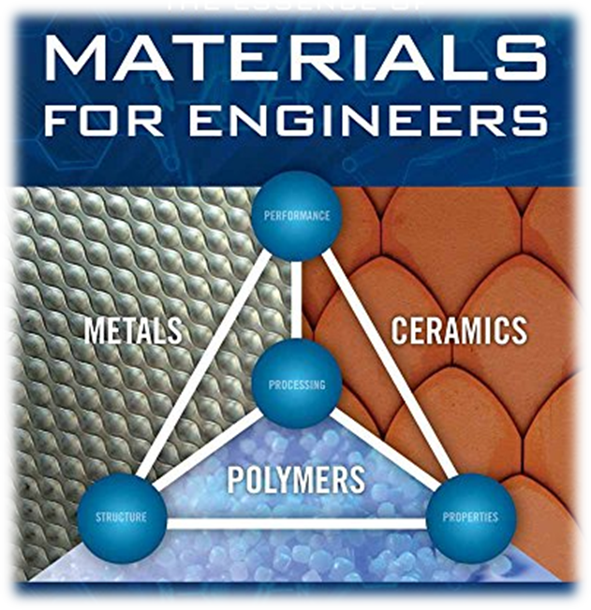
  Material Selection

Slide 2
Material Selection
Selecting an appropriate material is a critical part of almost all engineering designs
There are many factors to consider
  Strength, stiffness, durability, corrosion, cost, formability, etc
Methods
  Experience: how do you get it? limiting
  Ashby selection charts
  (http://www-materials.eng.cam.ac.uk/mpsite/DT.html)
  Quantitative ranking of options (described here)

Slide 3
Overview
Important aspect of design for aerospace, mechanical, electrical, thermal, chemical or other applications is selection of best materials
Systematic selection of best material for a given application usually depends on 2 aspects:
  Properties
  Cost
A few examples:
  Thermal blanket must have poor thermal conductivity in order to minimize heat transfer for a given temperature difference
  Large amounts of copper in superconducting magnets: copper needed for low resistance path for large currents in case superconductivity lost
  Samarium-Cobalt Permanent Magnets on DS-1
  SR-71 structure: 85% titanium and 15% composite
  Hummer armor – should it be stiff or deflect against a bomb blast

Slide 4
Ashby Plots
Ashby plot is a scatter plot which displays two or more properties of a materials
Example of stiff, light part would have Young's modulus on one axis and density on other axis, with one data point on graph for each candidate material
  On such a plot, it is easy to find not only material with highest stiffness or lowest density, but that with best ratio E/ρ.
  Ashby plot on next slide shows density versus Young's modulus
    Metals are represented by blue squares, ceramics by green, and polymers by red
  Using a log scale on both axes facilitates selection of material with best plate stiffness
  Secondly plot shows same materials attributes for a database of approx 100 materials
    Materials families (polymers, foams, metals, etc.) are identified by the larger colored bubbles

Slide 5
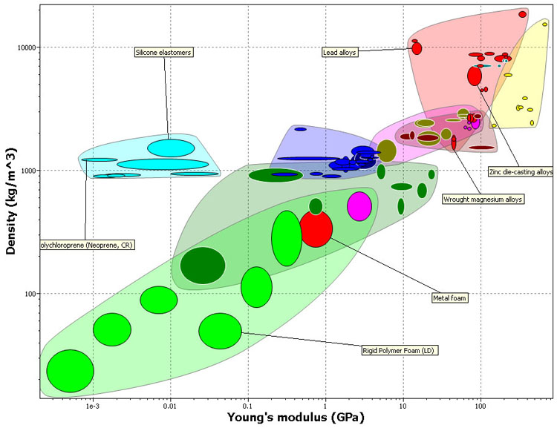
EXAMPLE OF ASHBY PLOT

Slide 6
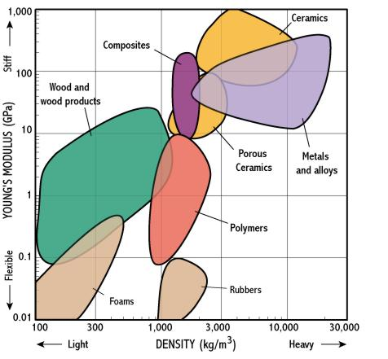
Ashby Material Selection Chart
http://www-materials.eng.cam.ac.uk/mpsite/tutorial/non_IE/selchart.html

Slide 7
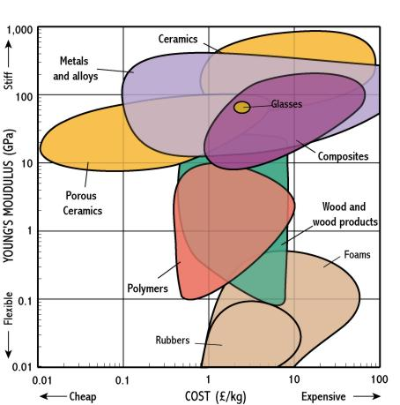
Young’s Modulus vs. Cost

Slide 8
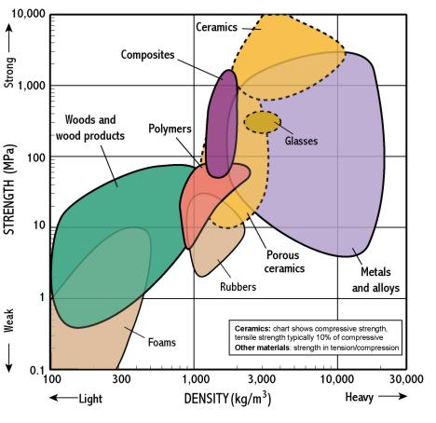
Strength Vs Density

Slide 9
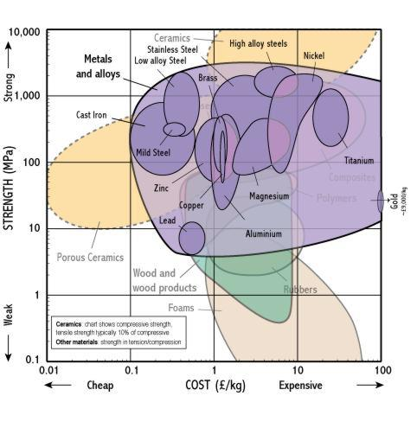
Strength Vs Cost

Slide 10
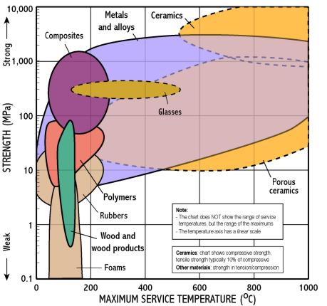
Strength Vs Max. Service temp

Slide 11
Cost Issues
Cost of materials plays a very significant role in their selection
Most straightforward way to weight cost against properties is to develop a monetary metric for properties of parts
For example, life cycle assessment can show that reducing weight of a car by 1 kg averages around $5, so material substitution which reduces weight of a car can cost up to $5 per kilogram of weight reduction more than original material
For commercial aircraft: $450/kg
Spacecraft: $20,000/kg
However, geography- and time-dependence of energy, maintenance and other operating costs, and variation in discount rates and usage patterns (distance driven per year in this example) between individuals, means that there is no single correct number for this

Slide 12
Cost Issues
As energy prices increase and technology improved, automobiles have substituted increasing amounts of light weight magnesium and aluminum alloys for steel
Aircraft are substituting carbon fiber reinforced plastic and titanium alloys for aluminum
Satellites have long been made out of exotic composite materials.
Cost per kg is not only important factor in material selection
An important concept is 'cost per unit of function'.
For example, if key design objective was stiffness of a plate of material, then designer would need a material with optimal combination of density, Young's modulus, and price
Optimizing complex combinations of technical and price properties is a hard process to achieve manually, so rational material selection software is an important tool – but lets see what we can do by hand…

Slide 13
Quantitative Ranking of Options for Material Selection
Objective: develop a rational method to select the best material for an application based upon known material parameters and the requirements of the application
Use a 5-step method
  Select a quantity, Q, to minimize or maximize
  Classify the variables
  Determine the relationship between the geometry variable, the requirements, and material properties
  Determine Q as a function of requirements and material properties
  Rank candidate materials based upon function f₂
* Based on N.E. Dowling, Mechanical Behavior of Materials, section 3.8

Slide 14
Step 1: Select a quantity, Q, to minimize or maximize
Mass (weight), m
Cost, C
are the most common and the only ones that we will consider

Slide 15
Step 2: Classify the variables
Requirements – variables that have prescribed values that will not change
Geometry – variables that define the dimensions of the component and depend implicitly upon the material properties
Material Properties – variables used to define the material in terms of physical behavior, mechanical behavior, and cost

Slide 16
Determine the relationship between the geometry variable, the requirements, and material properties
Step 3
Strength
  Bar, axial stress
  Beam, flexural stress
Stiffness
  Bar, deformation
  Beam, deflection

Slide 17
Determine Q as a function of requirements and material properties
Step 4
Q = f₁(requirements)* f₂(material props)

Slide 18
Rank candidate materials based upon function f₂
Step 5
If both weight and cost are important then separate rankings can be generated and results combined
Calculate geometry variable after ranking materials
  Adjustments may be necessary if calculated dimensions are impractical (either too large or too small)
There may be multiple requirements such as strength and serviceability
  Often material can be selected based on strength and then the serviceability requirements checked

Slide 19
Sample Problem
We must bridge a gap of L = 8’
The bridge must have a width of b = 4”
A load P = 300 lb can be applied at any point
There must be a safety factor X = 1.5 for strength
The deflection, v, must not exceed 1”
Weight (mass) and cost have equal importance
OBJECTIVE: select the best candidate material from…
AISI 1020 steel AISI 4340 steel
7075-T6 aluminum Ti-6Al-4V (titanium alloy)
Polycarbonate Loblolly pine
GFRP (glass fiber reinforced polymer)
CFRP (carbon fiber reinforced polymer)

Slide 20
Step 1: Select a quantity, Q, to minimize
Here, mass and cost have equal importance
Mass, m
Cost, C
Select Q to be the sum of the normalized mass and cost
Q = m/min(m) + C/min(C)

Slide 21
Step 2: Classify the variables
Requirements: L = 8’, b = 4”, P = 300 lb, X = 1.5, v = 1”
Geometry: restrict analysis to a rectangular cross-section, h = height
Material Properties (need step 3 & 4 results here): ρ = mass density, E = Young’s modulus, S = strength, C_{m} = cost index

Slide 22
Determine the relationship between the geometry variable, the requirements, and material properties
Step 3
We have a simply supported beam with a rectangular cross-section
The worst case occurs when the concentrated load, P, is applied at the center

Slide 23
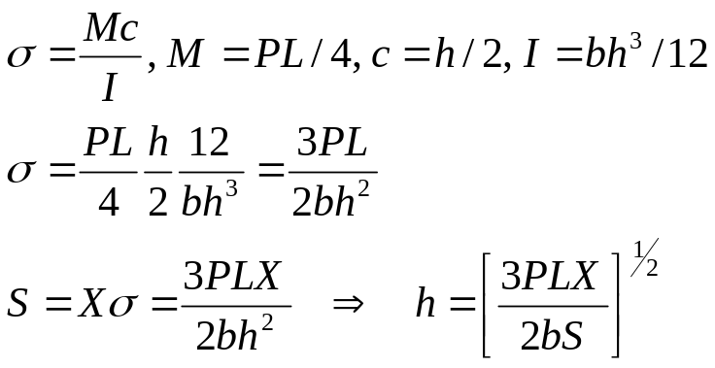
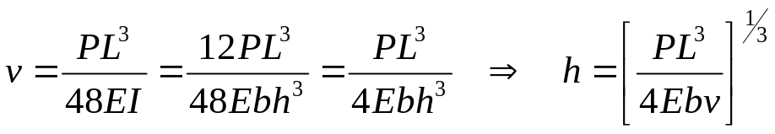
Deformation of Elastomers
P
h
b
L
Strength – elastic flexural formula shows the maximum stress
occurs at the extreme fibers of the beam at midspan
Deflection – from integration, is found to be maximum
at midspan

Slide 24
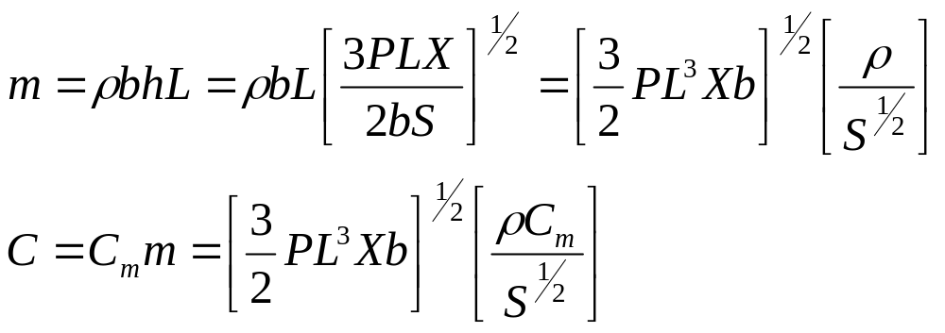
Determine Q as a function of requirements and material properties – strength basis
Step 4
Try using strength as the basis for material selection
and then check deflection
f₂

Slide 25
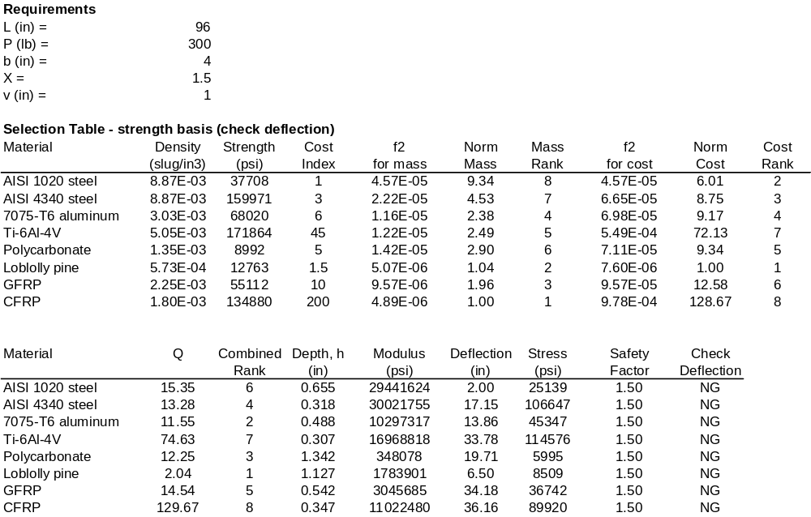
Rank materials based upon function f₂ – strength basis
Step 5
Use spreadsheet to
determine rankings

Slide 26
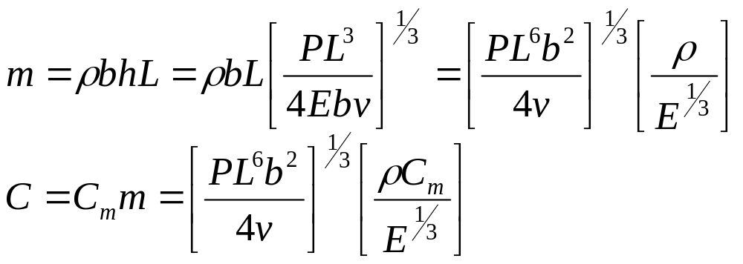
Determine Q as a function of requirements and material properties – deflection basis
Step 4
Try using deflection as the basis for material selection
and then check strength
f₂

Slide 27

Rank materials based upon function f₂ – deflection basis
Step 5B
Use spreadsheet to
determine rankings

Slide 28
Sample Problem Results
Material selection based only on strength results in the deflection criterion being violated
Material selection based only on deflection results in the strength criterion being satisfied
We can say that deflection governs this design
Pine is best, 1020 steel is second best, CFRP is worst

Slide 29


